Slide 1
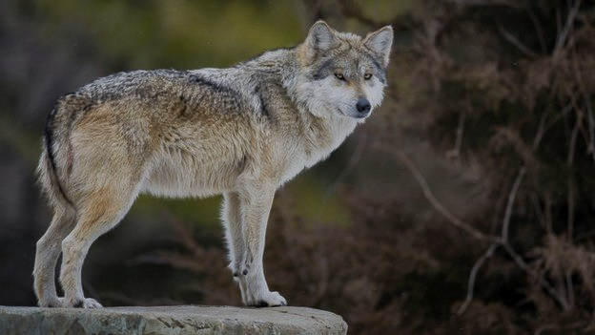
Wolves population of
Polish National Parks
Around the Poland lives about 1000 wolves.
Despite of what common opinion states wolves aren’t danger to human life. In fact it is opposite, people can do much more harm to wolves than wolves to people.
Poland is one of a wolves refuge in the European Union. It is the Poland that the wolves start their migration to the countries west from river Odra.

Slide 2
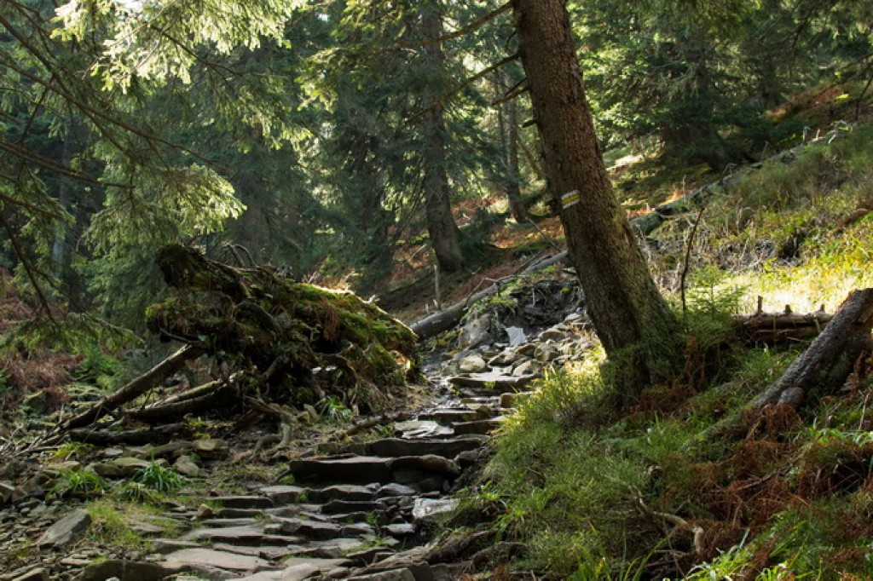
Babiogórski National Park

Slide 3

The presence of the Wolf In the park
Wolves after a long period of absence they appeared in the park in the 80’s of the last century.
Wolves tracks during the annual track game run through the park and were registered only in the 1987 and 1988
Since these moments animals occur regularly.

Slide 4

Wolves were found in the park throughout in whole their region, but primarily in the mountain.
Wolf was in the region of Babia Góra as top predator. Not long ago lynx was the only predator in that region. The wolf is the constant monitoring subject.
The conducted observations revealed the presence of two packs, the boundaries of the territories run through the park.

Slide 5
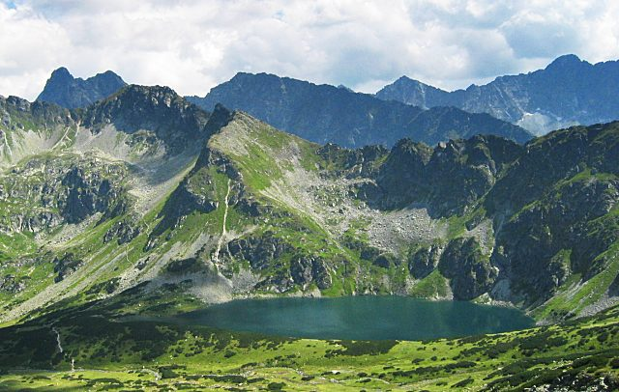
Tatrzański National Park

Slide 6

The historical documents show that wolves were rare species in Tatra mountain in the past. After a long period of ruthless and effective extermination only in the 80s of the XX century settle these predators. The date show there are mainly in floors and foothills.
In the first years of the XXI century ,the area TNP monitoring showed the occurrence and success of breeding wolves using the method…

Slide 7

The numbers of these predators were estimated at over a dozen individuals. Within one breeding season documented the wolf were presence up 2 families. Victims of wolves in the Tatra’s are mainly large mammals, such as deer.
Monitoring the animals kept in TNP showed the 2006-2008 wolf predation accounted for 53% of all documented causes of falls deer.

Slide 8
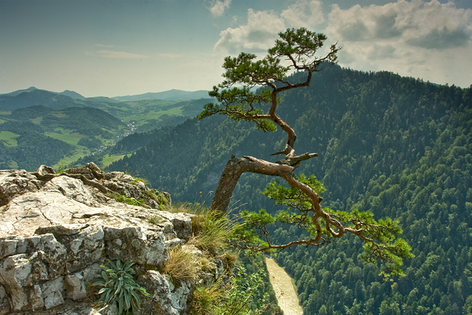
Pieniński National Park

Slide 9
Between 19th and 20th century this predator did not appear yet. For a number of years the wolf appeared in the park rarely. Wolves were mostly observed in the sheep breeding neighbouring areas.
In recent of years there were only 6 direct observations of these predators.

Slide 10
The wolves existence recently registered in the western part of PNP and it’s buffer zone from the Lubania which way to run steady migration route wolves in Gorce.
The most common prey these predators are sheep, but they hunt for deer and wildboar too.

Slide 11
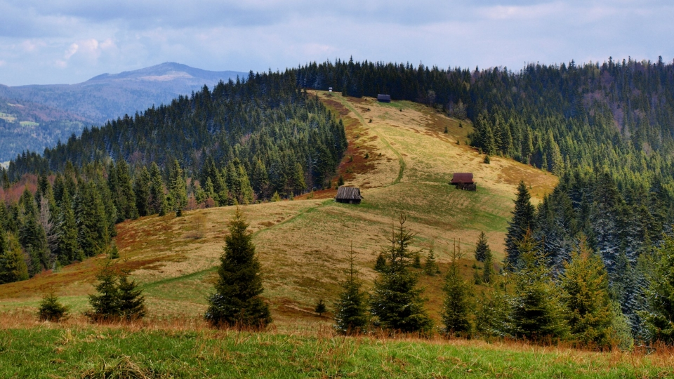
Gorczański National Park

Slide 12
Wolves in the mid–nineteenth century were frequent. Later, as a result of the condemnation of their size, the number decreased in 1981.
It turned out to be very beneficial for the wolves, because here it was the appropriate habitat and at the same time they gained more peace of quiet.

Slide 13
In 2012, the inventory showed the presence of 6-9 wolves inhabiting this area GNP and its surroundings. The GNP area plays for wolves important breeding vole. Well-preserved old forest stands in its state original with the little interference by the people is great place for breeding the youngs.
The most common prey of wolves are deer, roe deer and wildboars. It happens that the prey also are sheep.

Slide 14
Authors
Katarzyna Pniewska – klasa 3 „b”
Agata Prątnicka – klasa 2 „a”
Artur Kowal – klasa 2 „a”
From
Zespół Szkół Leśnych
im. Romana Gesinga w Zagnańsku

Slide 15
List of sources
http://www.national-geographic.pl/aktualnosci/wilkow-nie-trzeba-sie-bac-trzeba-je-adoptowac
Sławomir Wąsik
Jamrozy G. red. 2014. „Ssaki polskich parków narodowych”. Instytut Bioróżnorodności Leśnej WL UR w Krakowie, Magurski Park Narodowy, Kraków - Krempna.
qz.com
www.lasy.gov.pl
www.goodpoland.com
pieniny-serwis.pl
www.bbc.com

